Slide 1

Discussão de Casos clínicos: A imunoterapia no tratamento dos Linfomas
Dra Talita Silveira CRM 113065
Onco-hematologia ACCC
MD; PhD

Slide 2
Declaração de Conflitos de Interesse – Dra Talita Silveira
De acordo com a resolução 1595/2000 do Conselho Federal de Medicina e com a RDC 96/2008 da ANVISA, eu declaro
Speaker: BMS, MSD

Slide 3


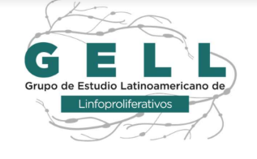


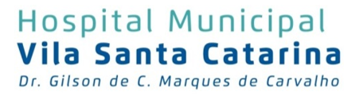
Como o tratamento do LH e do PMBL está mudando?
Guilherme Fleury Perini, MD
CRM: SP0114634
Américas Oncologia
Hospital Israelita Albert Einstein
Hospital Municipal da Vila Santa Catarina
@guiperiniMD

Slide 4
Declaração de Conflitos de Interesse – Dr Guilherme Perini
De acordo com a resolução 1595/2000 do Conselho Federal de Medicina e com a RDC 96/2008 da ANVISA, eu declaro
Speaker: Janssen, Roche, Takeda, Abbvie, Astra Zeneca, MSD
Educacional: Janssen, Takeda, Roche, Abbvie
Advisory Board: Janssen, Abbvie, Astra Zeneca, MSD
Pesquisa: Janssen, Millenium, MSD, Alnylam, Astra Zeneca

Slide 5
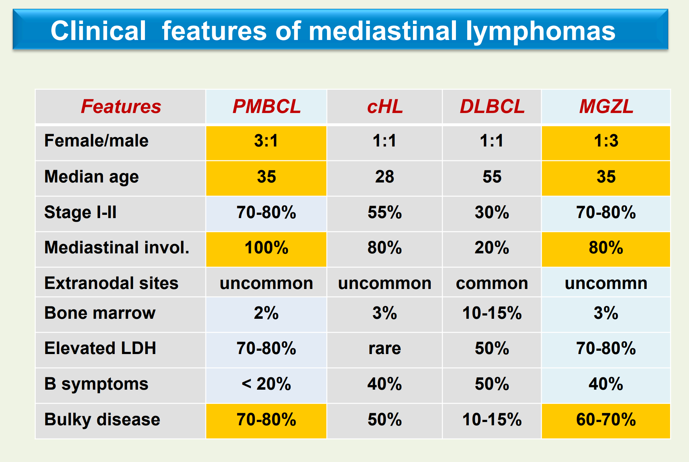
LH e PMBL são doenças relacionadas…
Martelli M et al, EHA 2014

Slide 6
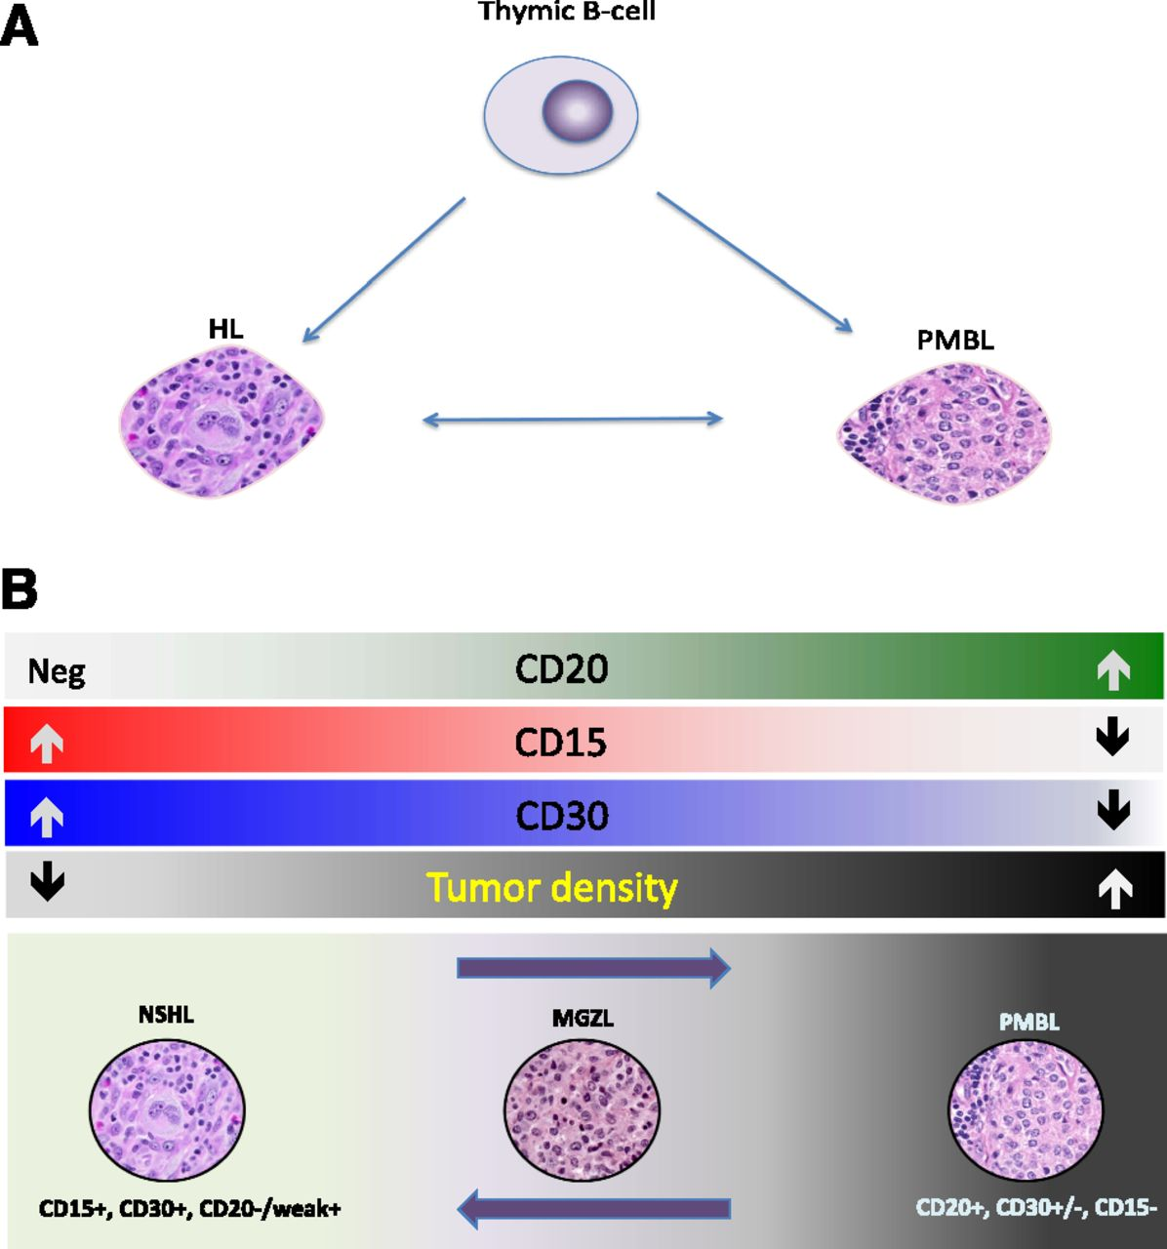
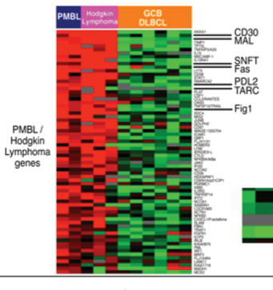
As semelhanças não são só clínicas...
Dunleavy K et al, Medicine 2015
Martelli M et al, EHA 2014

Slide 7
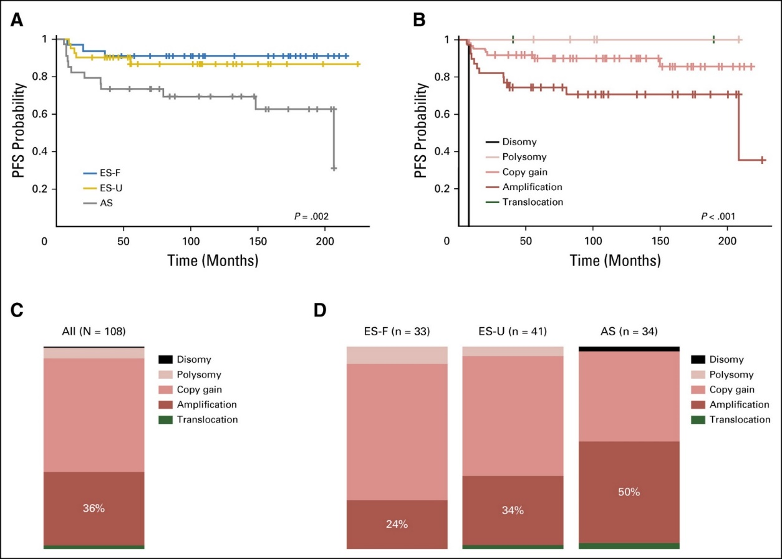
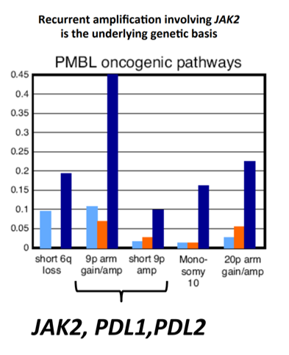
O Locus 9p24 em LH e PMBL
Roemer et al, JCO 2016

Slide 8
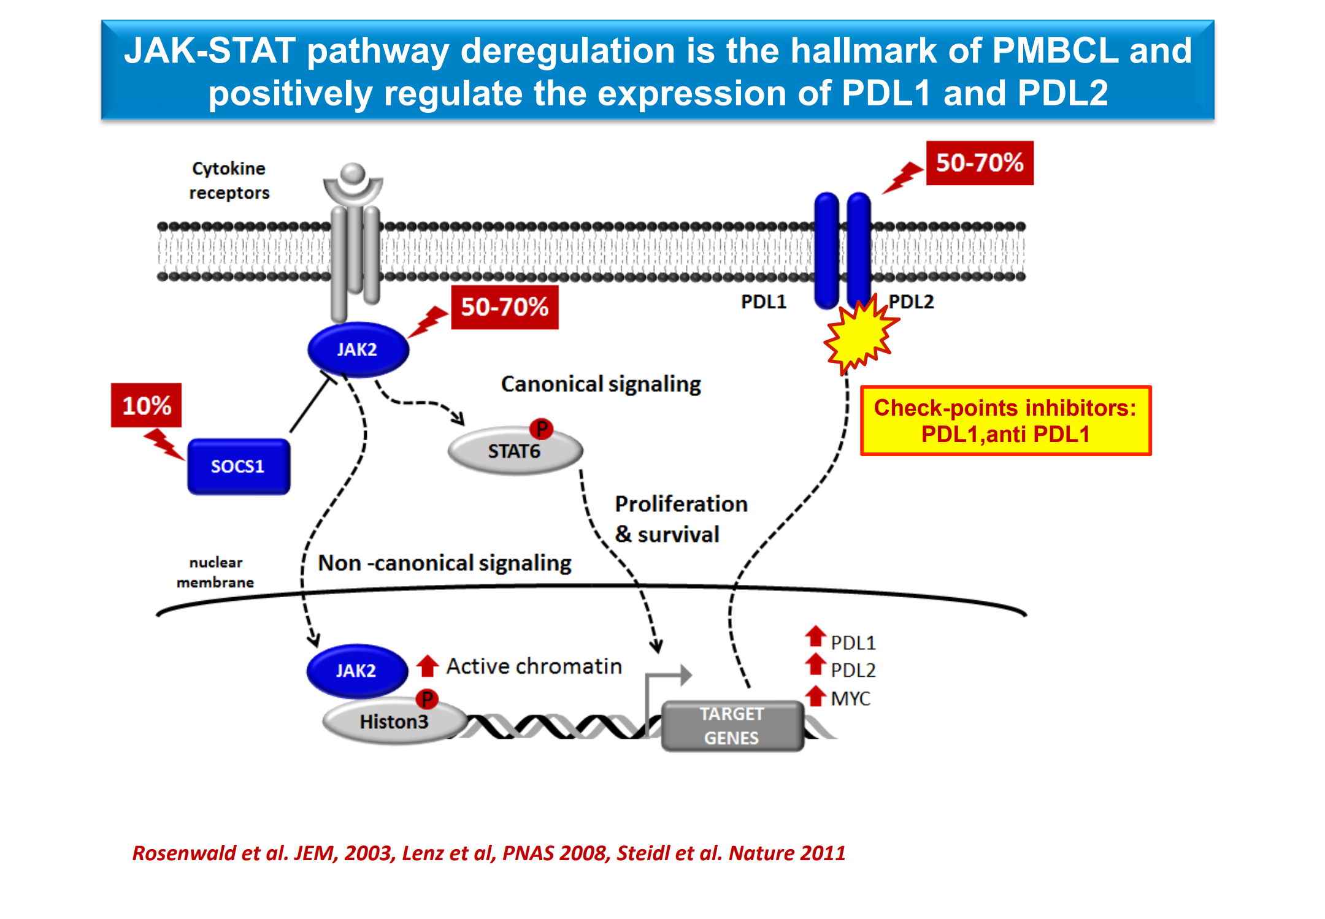

Slide 9
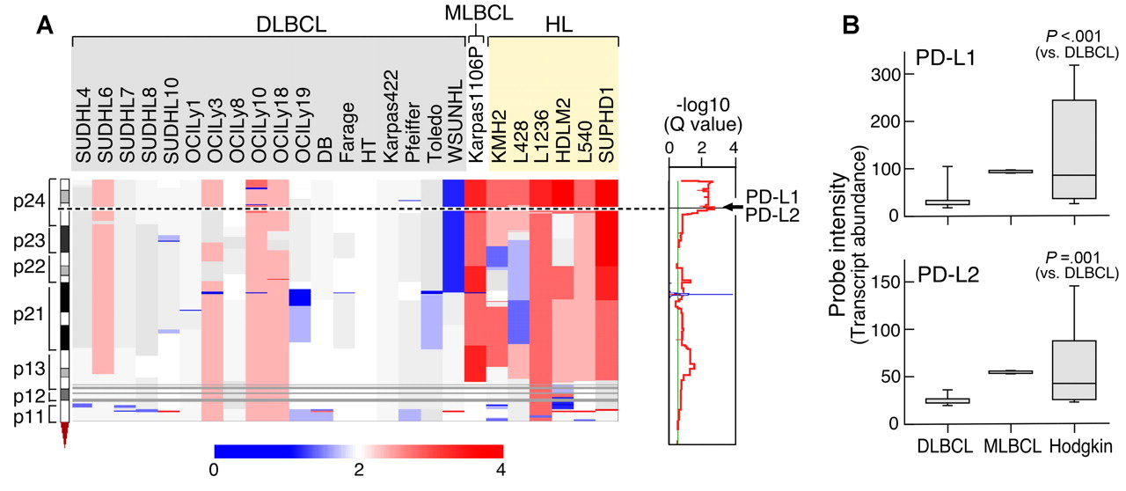
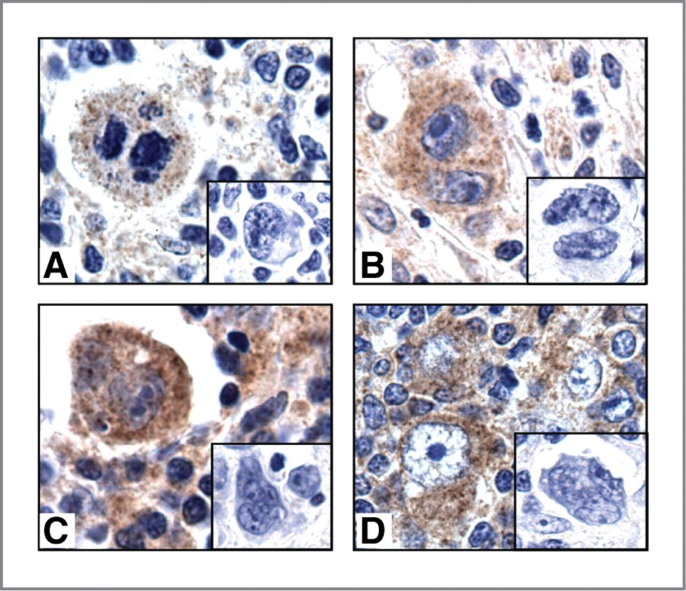
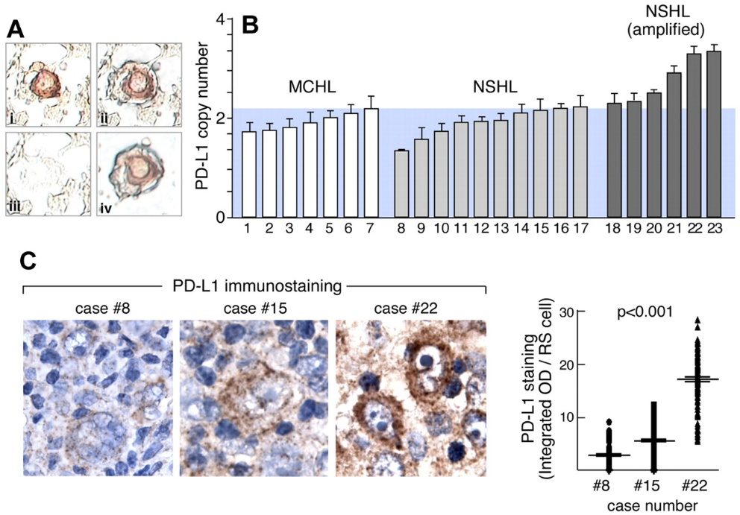
PD-L1 e PD-L2 nos LH e no PMBL
Green MR et al. Blood, 2010

Slide 10
Conclusões
Ambos LH e PMBL tem como alteração genética principal os ganhos do 9p24
2 genes principais relacionados: PDL1 e Jak2
Ambos são caracterizados por expressão de PDL-1/PDL-2 por IHQ
Como Podemos aproveitar estes achados?
Slide do autor

Slide 11
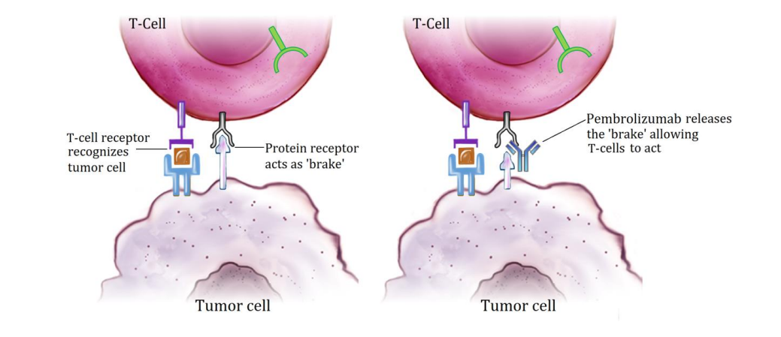
Explorando a Imunoterapia
Wahid M et al, Crit Rev Oncol 2017

Slide 12

Imunoterapia no tratamento dos Linfomas
Casos Clínicos
Guilherme Fleury Perini, MD
CRM-SP: 114634
Américas Oncologia
Hospital Israelita Albert Einstein
Hospital Municipal da Vila Santa Catarina
@guiperiniMD

Slide 13
Caso 1
Paciente de 32 anos, sexo feminino:
  LH EN IVB (osso)
  6x ABVD
    Refratário
  2x ICE
    Refratário
Como resgatar esta paciente?
  BV?
  Pembro?
  Quimio?
Slide do autor

Slide 14
KEYNOTE-204 Study Design (NCT02684292)
Key Eligibility Criteria
Relapsed or Refractory cHL
Relapse post−auto-SCT or ineligible for auto-SCT and failed one prior line of therapy
Measurable disease per IWG 2007 criteria¹
ECOG PS 0-1
BV-naive and BV-exposed patients eligible
Pembrolizumab
200 mg IV Q3W
Up to 35 Cycles
Response assessed Q12W per IWG 2007 Revised Response Criteria for Malignant Lymphoma¹
AEs evaluated Q3W throughout the trial period, and Q12W during follow-up
R
1:1
Brentuximab Vedotin
1.8 mg/kg IV Q3W
Up to 35 Cycles
Primary End Point: PFS per blinded independent central review (BICR) by IWG 2007 criteria including clinical and imaging data following auto-SCT or allogeneic stem cell transplant (allo-SCT); OS
Secondary End Points: PFS per BICR by IWG 2007 criteria excluding clinical and imaging data following
auto-SCT or allo-SCT; ORR by BICR per IWG 2007;
PFS per investigator review; DOR; safety
Stratification Factors
Prior auto-SCT (yes vs no)
Status after 1L therapy (primary refractory vs relapsed <12 months vs relapsed ≥12 months after end of 1L therapy)
1. Cheson BD et al. J Clin Oncol. 2007;25:579-586.
BR-PDO-00221
Notes:
KEYNOTE-204 is a randomized, international, open-label, phase 3 study conducted to compare pembrolizumab and brentuximab vedotin in patients with R/R cHL.
Patients had R/R cHL, were post auto-SCT or ineligible for auto-SCT, had measurable disease and ECOG PS 0 or 1. Patients were stratified by prior auto-SCT and by disease status after 1L therapy
BV naïve and BV exposed patients were eligible as long as patients had a complete or partial response to treatment.
Patients were randomized 1:1 to receive pembrolizumab at 200 mg Q3W or BV at 1.8 mg/kg Q3W
Primary end points were PFS per BICR by IWG 2007 revised response criteria including clinical and imaging data following auto or allo-SCT and OS
Secondary endpoints were PFS per BICR by IWG 2007 response criteria excluding clinical and imaging data following auto or allo SCT, PFS per investigator review, ORR by BICR, duration of response and safety

Slide 15
Primary End Point: Progression-Free Survival Per Blinded Independent Central Review
Including Clinical and Imaging Data Following Auto-SCT or Allo-SCT
100
90
 | Events n (%) | HR (95% CI) | P value
Pembro | 81 (53.6) | 0.65 (0.48-0.88) | 0.00271
BV | 88 (57.5)
80
53.9%
35.6%
70
60
Progression-Free Survival, %
50
40
Median (95% CI)
13.2 mo (10.9-19.4)
8.3 mo (5.7-8.8)
30
20
10
0
0
3
6
9
12
15
18
21
24
27
30
33
36
39
Months
No. at Risk
Pembro | 151 | 116 | 96 | 74 | 65 | 55 | 44 | 35 | 18 | 15 | 9 | 4 | 1 | 0
BV | 153 | 103 | 63 | 41 | 32 | 26 | 19 | 14 | 10 | 7 | 5 | 2 | 1 | 0
Data cutoff: January 16, 2020.
Presented By John Kuruvilla at ASCO 2020
BR-PDO-00221
Notes:
The KEYNOTE-204 study met its primary endpoint for PFS
Median PFS including clinical and imaging data following auto or allo-SCT was statistically significantly greater with pembrolizumab vs BV
Median PFS for pembrolizumab was 13.2 months and for BV was 8.3 months
HR of 0.65 and a P-value of 0.00271
The 12-month PFS rate was 53.9% with pembrolizumab and 35.6% with BV

Slide 16
Progression-Free Survival Per Investigator Review
100
 | Events, n (%) | HR (95% CI)
Pembro | 73 (48.3) | 0.49 (0.36-0.67)
BV | 95 (62.1)
90
80
62.2%
33.0%
70
60
Progression-Free Survival, %
50
40
Median (95% CI)
19.2 mo (13.8-28.1)
8.2 mo (5.7-8.6)
30
20
10
0
0
3
6
9
12
15
18
21
24
27
30
33
36
39
Months
No. at Risk
Pembro | 151 | 128 | 108 | 84 | 75 | 66 | 55 | 45 | 24 | 17 | 9 | 4 | 1 | 0
BV | 153 | 107 | 66 | 44 | 32 | 27 | 19 | 15 | 11 | 7 | 5 | 2 | 1 | 0
Data cutoff: January 16, 2020.
Presented By John Kuruvilla at ASCO 2020
BR-PDO-00221
Notes:
Median PFS by investigator review was higher with pembrolizumab versus BV (19.2 vs 8.2 months)
12-month PFS rate was 62.2% with pembrolizumab and 33.0% with BV

Slide 17
Duration of Response by Blinded Independent Central Review
 | Duration of Response, median (range), months
Pembro | 20.7 (0.0+ to 33.2+)
BV | 13.8 (0.0+ to 33.9+)
100
90
80
62.4%
50.0%
70
60
Remaining in Response, %
50
40
30
20
10
0
0
3
6
9
12
15
18
21
24
27
30
33
36
39
Months
No. at Risk
Pembro | 100 | 81 | 66 | 57 | 48 | 39 | 31 | 15 | 11 | 6 | 3 | 1 | 0 | 0
BV | 83 | 56 | 34 | 29 | 23 | 18 | 13 | 9 | 7 | 5 | 3 | 1 | 0 | 0
Data cutoff: January 16, 2020.
Presented By John Kuruvilla at ASCO 2020
BR-PDO-00221
Notes:
The duration of response was higher with pembrolizumab than with BV (20.7 months vs 13.8 months)
62.4% of patients on pembrolizumab and 50% of patients on BV had a response ≥12 months

Slide 18
Caso 1
Pembro x4: PR
Pembro x6: CR
Quais próximos passos?
  ASCT?
  Allo?
  Manter CPI?
BR-PDO-00221
Slide do autor

Slide 19
Subsequent ASCT by Prior Line of Therapy
1 prior line of therapy: 7 (25.9%) and 9 (33.3%) patients in the pembro and BV groups, respectively
  1 (3.7%) patient in the BV group subsequently underwent allo-SCT
≥2 prior lines of therapy: 23 (19.0%) and 25 (20.0%) patients in the pembro and BV groups, respectively
  14 (11.6%) patients in the pembro group and 12 (9.6%) patients in the BV subsequently underwent allo-SCT
Data cutoff: January 16, 2020.
Presented By John Kuruvilla at ASH 2020
BR-PDO-00221
Notes:
In patients receiving 1 prior line of therapy, there were 7 (25.9%) in the pembrolizumab group and 9 (33.3%) in the BV group
1 (3.7%) patient in the BV group subsequently underwent allo-SCT
In patients receiving 2 or more prior lines of therapy, there were 23 (19.0%) in the pembrolizumab group and 25 (20.0%) in the BV group
14 (11.6%) patients in the pembrolizumab group and 12 (9.6%) patients in the BV group subsequently underwent allo-SCT

Slide 20
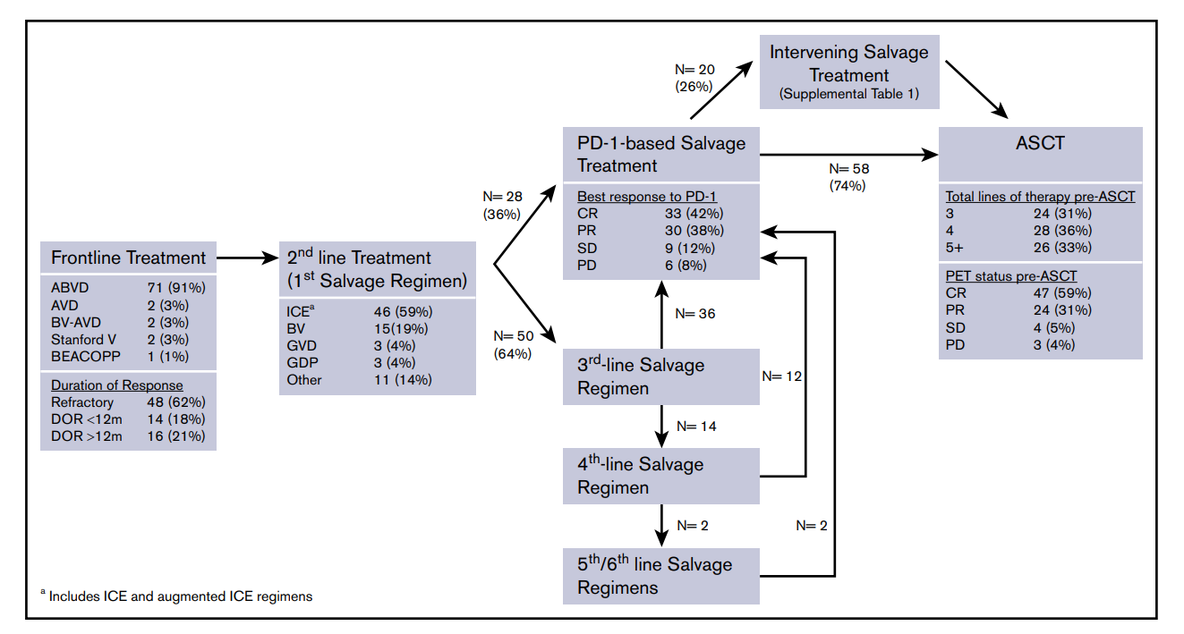
ASCT após CPI: O que temos de dados?
BR-PDO-00221
Merryman RW et al, Blood Advances 2021

Slide 21
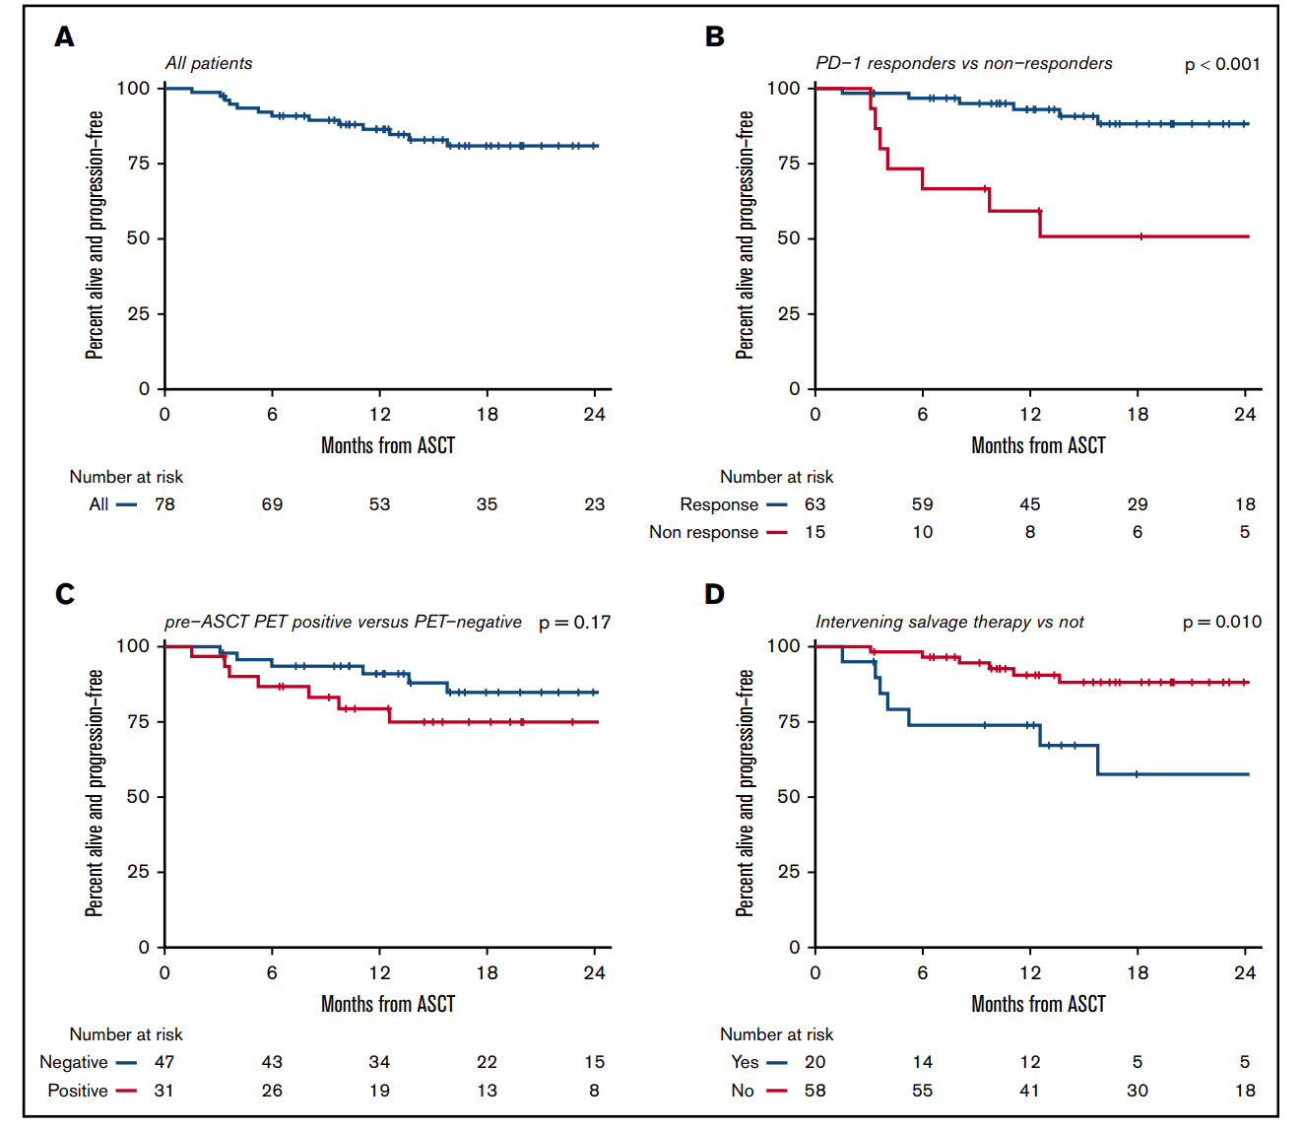
BR-PDO-00221
Merryman RW et al, Blood Advances 2021

Slide 22
Caso 1
Os CPI parecem aumentar efeito de QT em LH:
  2-y PFS 100% Pembro-AVD (Allen, Blood 2021)
  ORR 100%, CR 95% Pembro-GVD (Moskowitz, JCO 2021)
ASCT parece ser uma boa opção de consolidação em pacientes com LH que recebem CPI em linhas mais precoces, em especial em pacientes respondedores
Slide do autor

Slide 23
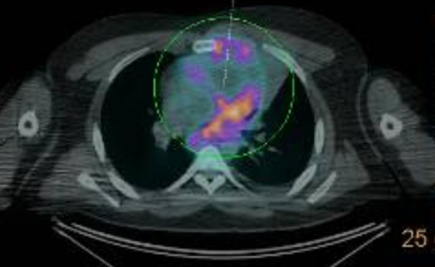

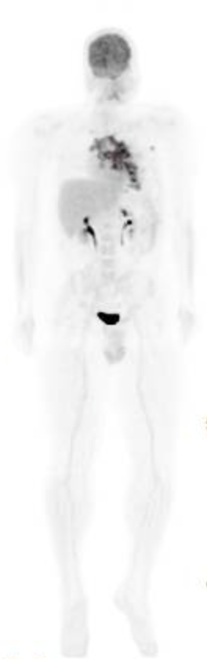
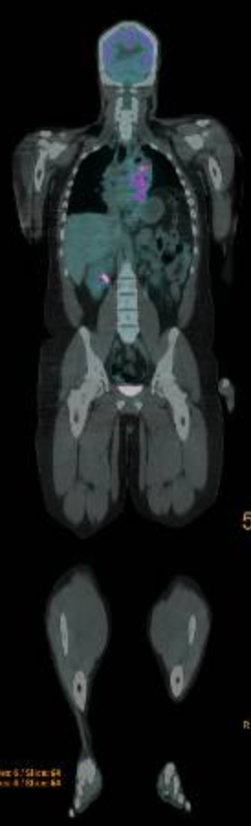
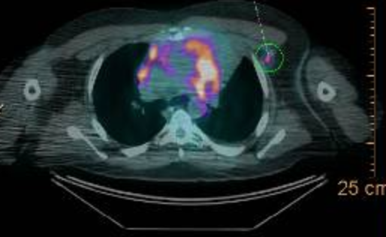
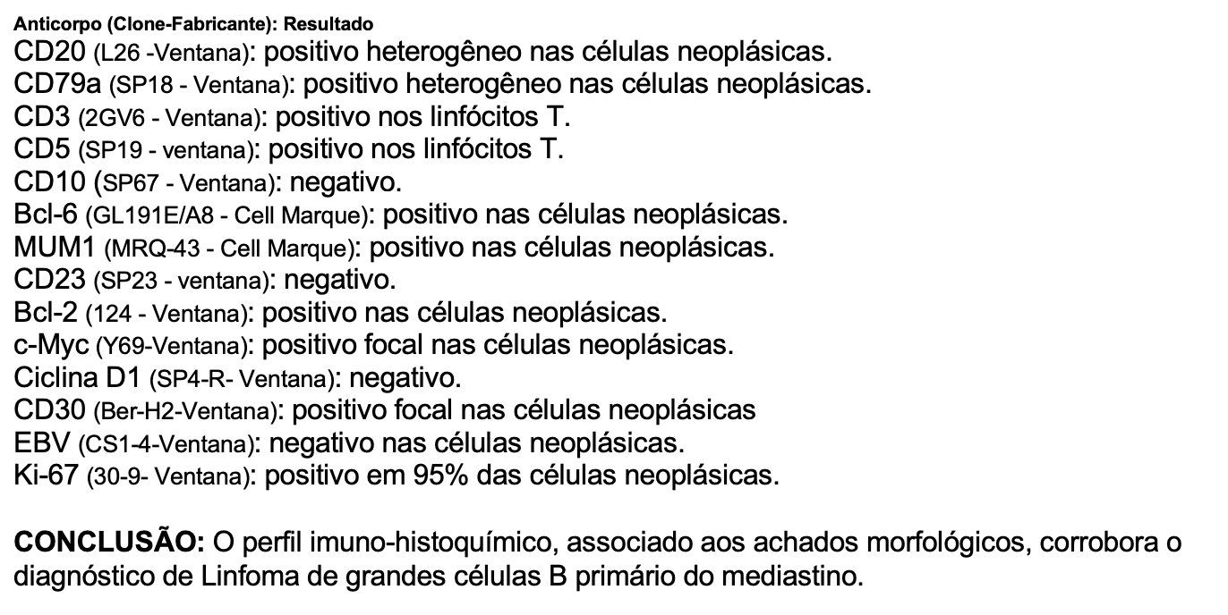
Abril 2022
Edema de face
Dor torácica
25 y/o, masculino, obeso
LPM
R-da-EPOCH
BR-PDO-00221
Talita Silveira; Thaís Fisher

Slide 24
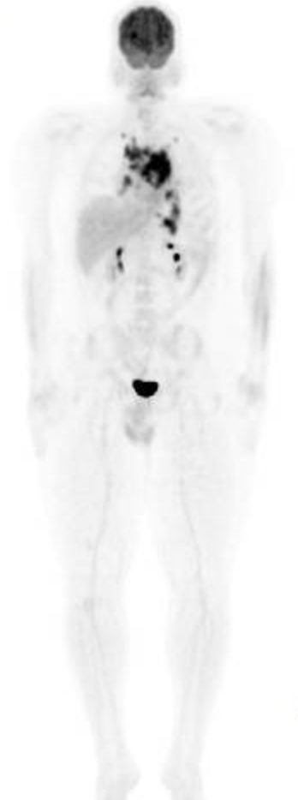
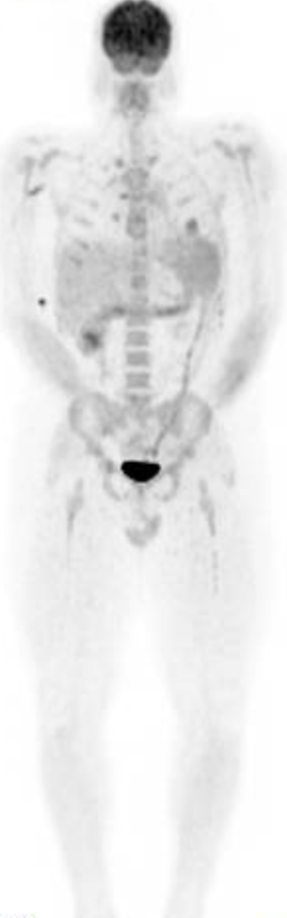
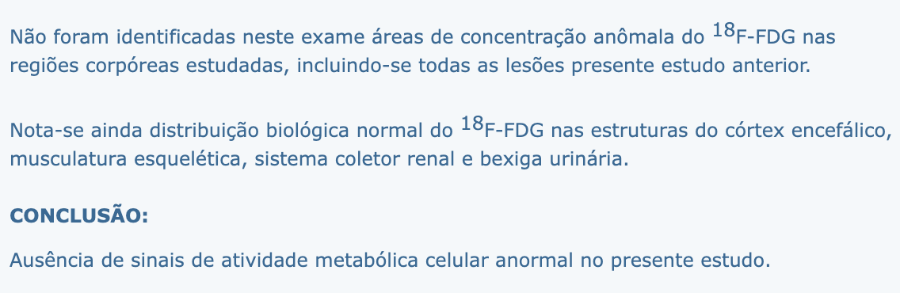
Abril 2022
May 2022
Dor torácica e dispnéia
RC apos C3
25 y/o, masculino, obeso
LPM
R-da-EPOCH x3
R-da-EPOCH
BR-PDO-00221
Talita Silveira; Thaís Fisher

Slide 25
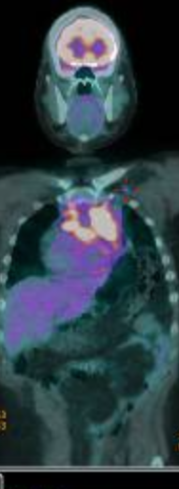
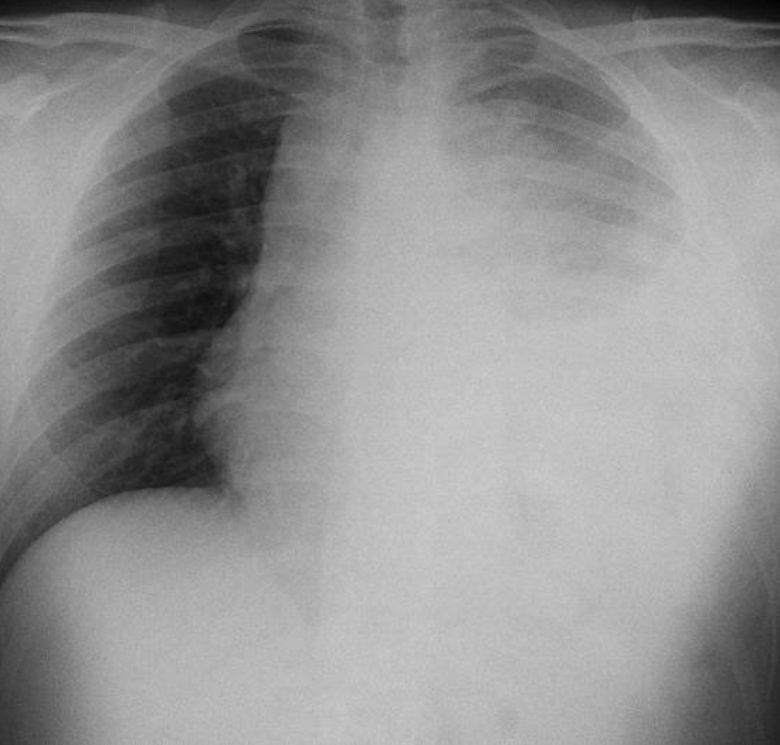
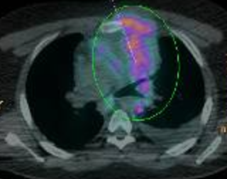
Abril 2022
May 2022
Nov 2022
Dor torácica e dispnéia
RC apos C3
PD enquanto aguardava reavaliação
Derrame pleural
Re-biopsia: LPM
25 y/o, masculino, obeso
LPM
R-da-EPOCH x3
R-da-EPOCH x6
R-da-EPOCH
R-DHAX
Pembro
BR-PDO-00221
Talita Silveira; Thaís Fisher

Slide 26
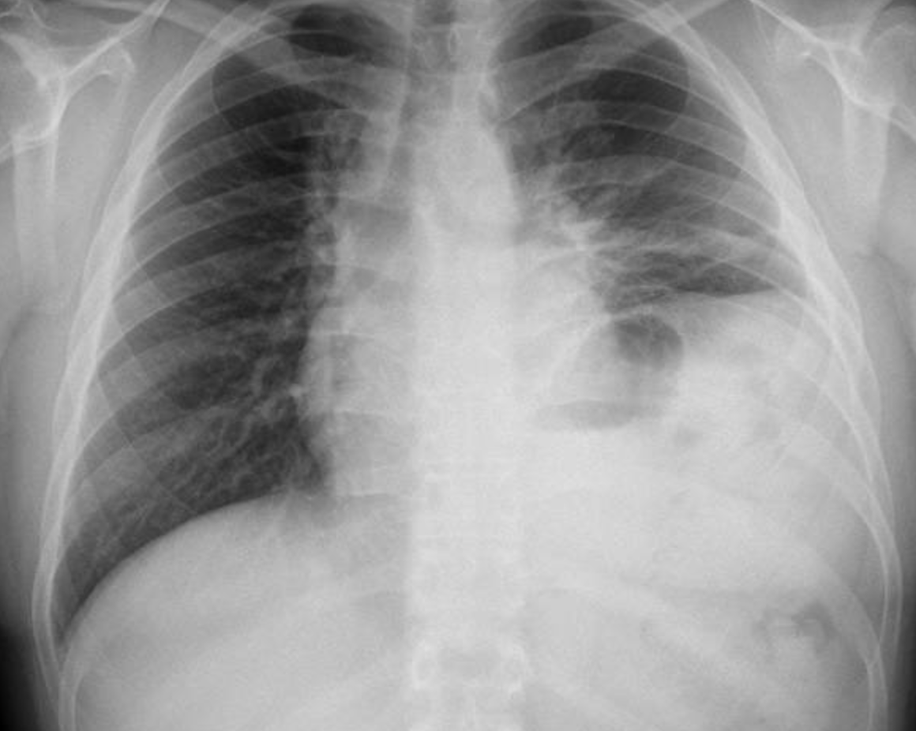
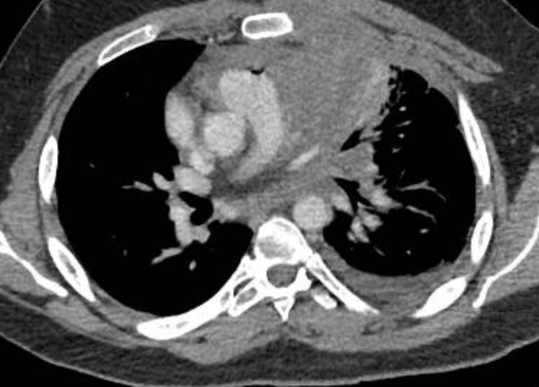
25 y/o, masculino, obeso
Abril 2022
May 2022
Nov 2022
Fev 2023
Dor torácica e dispnéia
RC apos C3
PD enquanto aguardava reavaliação
Derrame pleural
Re-biopsia: LPM
Excelente tolerancia
Aguarda reaval Pet-Ct
LPM
R-da-EPOCH x3
R-da-EPOCH x6
Pembro x6
R-da-EPOCH
Pembro
Rdt
BR-PDO-00221
Talita Silveira; Thais Fischer

Slide 27
LDGCB primário mediastino
3-10% todos LDGCB
2-4% todos linfomas
Jovens
Mulher > homem
10-30% recidiva (6-18 meses após término terapia)
Takyar J. Exp. Rev. Hematol. 2020
BR-PDO-00221

Slide 28
Coorte Brasileira
Velasques R. J. Oncology. 2022
BR-PDO-00221

Slide 29
Velasques R. J. Oncology. 2022
BR-PDO-00221

Slide 30
Análise mundo real refratários
BR-PDO-00221
Takyar J. Exp. Rev. Hematol. 2020

Slide 31
LDGCB primário refratário
Takyar J. Exp. Rev. Hematol. 2020
BR-PDO-00221

Slide 32
Final Analysis of KEYNOTE-170: Pembrolizumab in Relapsed or Refractory Primary Mediastinal Large B-Cell Lymphoma
P.L. Zinzani¹; C. Thieblemont²; V. Melnichenko³; K. Bouabdallah⁴; J. Walewski⁵; A. Majlis⁶; L. Fogliatto⁷;
A.M. Garcia-Sancho⁸; B. Christian⁹; Z. Gulbas¹⁰; M. Özcan¹¹; G.F. Perini¹²; G. Salles¹³; M.A. Shipp¹⁴;
S. Thompson¹⁵; S. Chakraborty¹⁵; P. Marinello¹⁵; P. Armand¹⁴
¹IRCCS Azienda Ospedaliero-Universitaria di Bologna Istituto di Ematologia “Seràgnoli” and Dipartimento di Medicina Specialistica, Diagnostica e Sperimentale Università di Bologna, Bologna, Italy; ²Hemato-Oncology Department, APHP, Saint-Louis Hospital, Paris, France; ³Pirogov National Medical Surgical Center, Moscow, Russia; ⁴Department of Hematology and Cell Therapy, University Hospital, Bordeaux, France; ⁵Maria Sklodowska-Curie National Research Institute of Oncology, European Reference Network, Warszawa, Poland; ⁶Clinica Alemana de Santiago, Vitacura, Chile; ⁷Hospital de Clinicas de Porto Alegre, Porto Alegre, Brazil; ⁸Hematology Department. Hospital Universitario de Salamanca. IBSAL, CIBERONC, Salamanca, Spain; ⁹The James Cancer Hospital and Solove Research Institute, The Ohio State University, Columbus, OH, USA; ¹⁰Anadolu Medical Center, Gebze, Turkey; ¹¹Ankara University Faculty of Medicine, Department of Hematology and Bone Marrow Transplantation Unit, Ankara, Turkey; ¹²Hospital Israelita Albert Einstein, Sao Paulo, Brazil; ¹³Hématologie, Hospices Civils de Lyon and Université de Lyon, Lyon, France; ¹⁴Dana-Farber Cancer Institute, Boston, MA, USA; ¹⁵Merck & Co., Inc., Kenilworth, NJ, USA
BR-PDO-00221
Notes:
Good afternoon, I’m Dr. Zinzani, presenting the final analysis for the multicenter, single-arm, open label phase 2 KEYNOTE-170 study of pembrolizumab monotherapy in patients with relapsed or refractory primary mediastinal B-cell lymphoma.

Slide 33
Baseline Demographics and
Study Disposition
Characteristic, n (%) | Pembrolizumab N = 53
Age, median (range), years | 33.0 (20 to 61)
Female | 30 (56.6)
ECOG 1 | 30 (56.6)
Prior transplant | 14 (26.4)
Prior lines of therapy, median (range) | 3.0 (2-8)
Prior radiation | 17 (32.1)
Prior rituximab | 53 (100.0)
Patients in population, n (%) | Pembrolizumab N = 53
Completed 2 years of treatment | 13 (24.5)
Discontinued | 40 (75.5)
Adverse Event | 6 (11.3)
Clinical Progression | 12 (22.6)
Complete Response | 1 (1.9)
Progressive Disease | 18 (34.0)
Physician Decision | 3 (5.7)
Data cutoff date: October 23, 2020.
BR-PDO-00221
Zinzani PL, et al ASH 2021
Notes:
Patients were heavily pretreated with all patients having received prior rituximab and 14 patients had prior transplant
Among all treated patients, 13 completed 2 years of treatment and 40 patients discontinued, primarily due to progressive disease

Slide 34
Summary of Best Response
 | Pembrolizumab N = 53 (IWG 2007)¹
Objective response rate,* n (% [95% CI]) | 22 (41.5 [30.0 to 53.7])
Complete response | 11 (20.8)
Partial response | 11 (20.8)
Stable Disease | 6 (11.3)
Progressive Disease | 13 (24.5)
Non-evaluable† | 1 (1.9)
No Assessment | 11 (20.8)
At data cutoff, no patient with complete response had progressed or received SCT
7 patients received transplant post-pembrolizumab
  5 autologous (BOR on pembrolizumab: 1 PR, 1 SD, 3 PD)
  2 allogenic (BOR on pembrolizumab: 2 PR)
1. Cheson BD et al. J Clin Oncol. 2007 Feb 10;25(5):579-586.
IWG, International Working Group.
*ORR by IWG 2007 per investigator assessment. †Non-evaluable patients with insufficient data for response per IWG 2007. Data cutoff date: October 23, 2020.
BR-PDO-00221
Zinzani PL, et al ASH 2021
Notes:
ORR was 41.5%, with 11 patients each achieving CR or PR, respectively
Six patients had stable disease and 13 patients had disease progression
Notably, no patient with CR had progressed or received SCT at data cutoff
7 patients received transplant post-pembrolizumab
5 autologous (BOR on pembrolizumab: 1 PR, 1 SD, 3 PD)
2 allogenic (BOR on pembrolizumab: 2 PR)

Slide 35
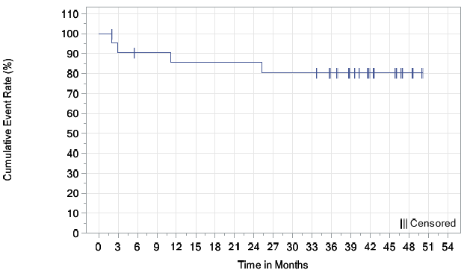
Duration of Response
80.6%
Cumulative Event Rate (%)
Median (95% CI)
NR (NR to NR)*
N at risk
Time, months
Pembrolizumab
22
19
18
18
17
17
17
17
17
16
16
16
13
11
7
6
2
0
0
At data cutoff, 22 (80.6%) patients achieved response and 2 patients maintained CR or PR for ≥4 years
*DOR by IWG 2007 per investigator assessment. Data cutoff date: October 23, 2020.
BR-PDO-00221
Zinzani PL, et al ASH 2021
Notes:
DOR was not reached and 80.6% of patients had a response ≥48 months

Slide 36
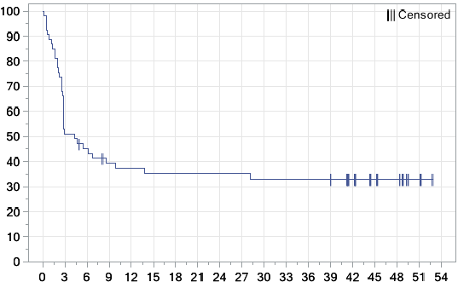
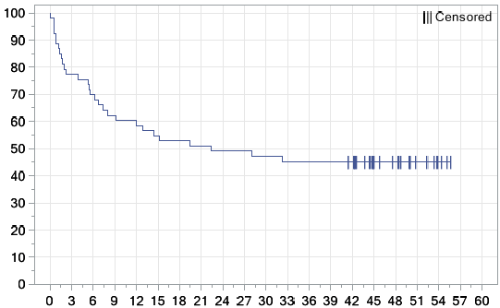
Progression-Free and Overall Survival
33.0%
45.3%
PFS, %
Median (95% CI)
OS, %
Median (95% CI)
4.3 mo (2.8 to 13.8)*
22.3 mo (7.3 to NR)
Time, months
Time, months
N at risk
N at risk
Pembrolizumab
53
27
23
19
18
17
17
17
17
17
16
16
16
15
12
7
6
2
0
Pembrolizumab
53
41
37
33
31
29
28
27
26
26
25
24
24
24
22
15
12
6
3
0
*PFS by IWG 2007 per investigator assessment. Data cutoff date: October 23, 2020.
BR-PDO-00221
Zinzani PL, et al ASH 2021
Notes:
Median PFS was 4.3 months and the 4-year PFS rate was 33.0%
Median OS was 22.3 months and the 4-year OS rate was 45.3%

Slide 37
Adverse Event Summary
Events, n (%) | KEYNOTE-170 N = 53
 | All | Grade 3-4
All treatment-related | 30 (57) | 12 (23)
Treatment-related events in ≥2 patients | All | Grade 3-4
Neutropenia | 10 (18.9) | 7 (13.2)
Asthenia | 5 (9.4) | 1 (1.9)
Hypothyroidism | 4 (7.5) | 0
Fatigue | 3 (5.7) | 0
Pyrexia | 3 (5.7) | 0
Arthralgia | 2 (3.8) | 0
Aspartate aminotransferase increased | 2 (3.8) | 1 (1.9)
Leukopenia | 2 (3.8) | 0
Myalgia | 2 (3.8) | 0
Hyperthyroidism | 2 (3.8) | 0
Vulvovaginal mycotic infection | 2 (3.8) | 0
White blood cell count decreased | 2 (3.8) | 0
There were no deaths due to treatment-related AEs
*All-cause immune-mediated events of any grade were hypothyroidism (n=4), hyperthyroidism (n=2), thyroiditis (n=1), and pneumonitis (n=1). Patients with multiple events in a system organ class are counted a single time for that organ class. Patients with multiple events are counted a single time for each specific event; Data cutoff date: October 23, 2020.
BR-PDO-00221
Zinzani PL, et al ASH 2021
Notes:
AEs of any grade related to study treatment occurred in 30 patients (56.6%)
The most commonly reported (incidence >5%) were neutropenia (18.9%), asthenia (9.4%), hypothyroidism (7.5%), and fatigue and pyrexia (5.7% each)
Grade 3-4 treatment-related AEs occurred in 22.6% of patients; only neutropenia occurred in ≥2 patients
No grade 5 treatment-related AEs occurred

Slide 38
Notas keynote-170
Tempo resposta: 3 meses
4 RC após 2 anos pembro estão em RC
9 TMO ( 4 auto- todos vivos; 5 alo)
In summary, these data demonstrated that treatment with pembrolizumab is an effective and safe option in patients with rrPMBCL who experience relapse after or are ineligible for autologous stem-cell transplantation.
BR-PDO-00221

Slide 39
BR-PDO-00221
Mondini M. Mol Oncology. 2020

Slide 40
Discussão
Pembro em RP: o que fazer?
Pembro em RC: o que fazer?
BR-PDO-00221

Slide 41
Obrigado!!
BR-PDO-00221

